Slide 1

6th Grade Accelerated Math
Unit 10, Lesson 8 Random Samples vs. Population Volume 2, pg. 146

Slide 2


Benchmark
MA.7.DP.1.3
Given categorical data from a random sample, use proportional relationships to make predictions about a population.
volume 2, pg. 146

Slide 3
Integrated Mathematical Thinking and Reasoning Standards
MA.K12.MTR.1.1 Actively participate in effortful learning both individually and collectively.
MA.K12.MTR.4.1 Engage in discussions that reflect on the mathematical thinking of self and others.
MA.K12.MTR.7.1 Apply mathematics to real-world contexts.
volume 2, pg. 146

Slide 4

Learning Target
I can determine if a sample is representative of the population.
volume 2, pg. 146

Slide 5

Warm-Up
volume 2, pg. 146

Slide 6
10.8.1 Warm-Up: Electric Vehicle Technician
Ben Grandy is an electrical vehicle technician for City Car Share. When Ben was considering what to do with his life, he knew he wanted to do something that would bring him happiness. Now he uses the skills he has gained from his study of landscape architecture and work as an electrical engineer to maintain the fleet of electric vehicles and electric bikes used by City Car Share. Ben found that dedicating himself to a cause that is bigger than himself brings him happiness.
volume 2, pg. 146
Notes:
Video Link: https://algebranation.wistia.com/medias/fi4fidi5y8

Slide 7
Think about what you would like to do with your life. What kind of work would make you happy?
In talking about his work, Ben said, “That’s how engineering and design is. You never get to a point where you think, ‘Oh, that’s perfect! That’s done.’ You start asking questions like, ‘Now that we’ve gotten this far, what’s the next step? How can we improve this?’”
How do you think having this mentality is helpful?
volume 2, pg. 146
Notes:
Video Link: https://algebranation.wistia.com/medias/fi4fidi5y8

Slide 8

Guided Instruction
volume 2, pg. 146

Slide 9

10.8.2 Guided Instruction: Is the Sample Representative of the Population?
Many organizations want to know how large groups of people think and behave. This helps businesses make decisions regarding what to sell, when to be open, and whom to target with advertisements. Research is also used to make predictions about events like elections, and to help doctors provide appropriate healthcare to their patients.
To gather this information, companies and organizations often collect data samples from a population they are studying.
volume 2, pg. 146

Slide 10

A population is the entire set of cases or individuals under consideration in a statistical analysis.
A sample is a subset, or part, of a population.
volume 2, pg. 146

Slide 11
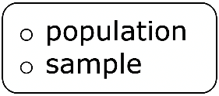
Imagine a group of researchers want to gather information about which candidate for sheriff all registered voters in Glades County, Florida plan to vote for in an upcoming election.
Use the definitions to complete the statements.
In this scenario, the being studied is
all registered voters in Glades County, Florida. It is not
realistic for researchers to ask every single registered
voter, so researchers would collect data from a
of registered voters in Glades County, Florida
to make predictions.
volume 2, pg. 146

Slide 12
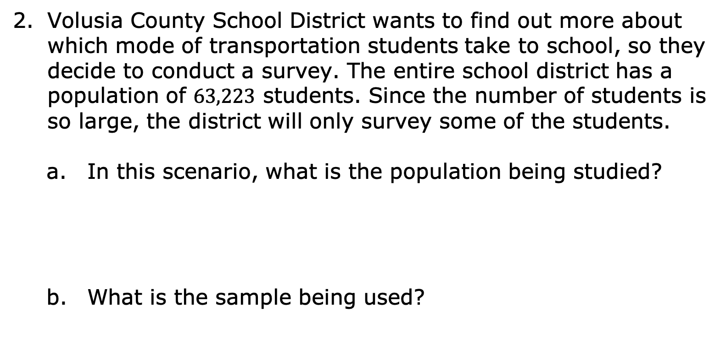
Volusia County School District wants to find out more about which mode of transportation students take to school, so they decide to conduct a survey. The entire school district has a population of $63,223$ students. Since the number of students is so large, the district will only survey some of the students.
In this scenario, what is the population being studied?
What is the sample being used?
volume 2, pg. 147

Slide 13

To ensure the students surveyed are representative of all students in Volusia County, a system is used to select who is surveyed.
A sample that is representative of a population resembles the population and can be used to make accurate predictions about the population.
volume 2, pg. 147

Slide 14
Twenty-five students from each grade level will be chosen at random to participate in the survey.
With your partner, discuss how you think this method will help ensure the sample is representative of the population.
volume 2, pg. 147

Slide 15
Claire wants to collect data on the highest education level achieved by adults in Jacksonville, Florida. She decides to go to the University of North Florida campus and ask the first person who comes into the library every 𝟑𝟎 minutes about their education level.
What is the population?
What is the sample?
volume 2, pg. 147

Slide 16

Explain why a sample chosen in this way may not be representative of the population.
A random sampling is a smaller group of people or objects chosen from a larger group or population by a process giving equal chance of selection to all possible people or objects, and all possible subsets of the same size.
volume 2, pg. 147

Slide 17

Collaboration
volume 2, pg. 148

Slide 18

10.8.3 Collaboration: Comparing Methods for Selecting Samples
For each scenario below, read the information about the study and answer the questions that follow.
Scenario 1: Lin is running for president of the seventh grade. She wants to predict her chances of winning the election. She is considering three different methods for surveying a sample of the students.
volume 2, pg. 148

Slide 19
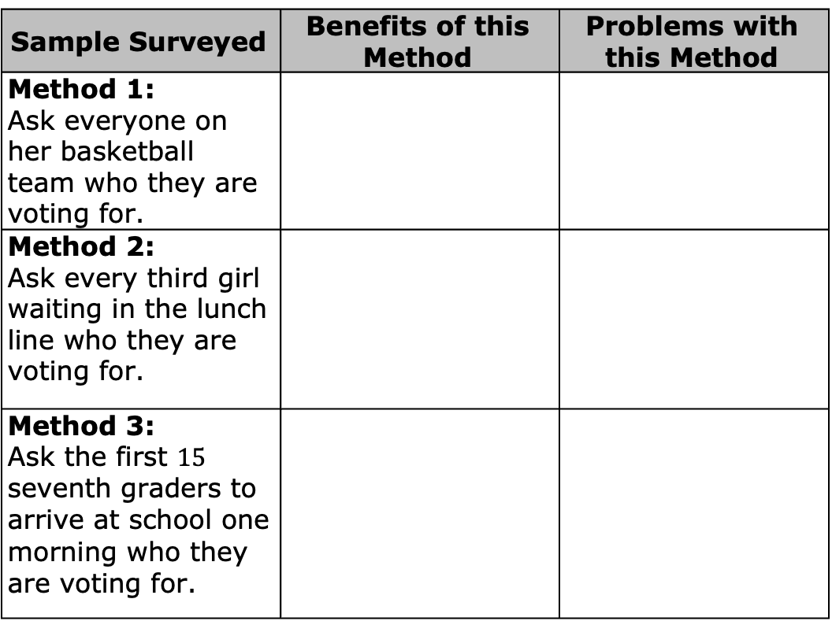
Complete the table to describe the benefits and problems with each of the possible survey methods described.
Sample Surveyed | Benefits of this Method | Problems with this Method
Method 1: Ask everyone on her basketball team who they are voting for.
Method 2: Ask every third girl waiting in the lunch line who they are voting for.
Method 3: Ask the first $15$ seventh graders to arrive at school one morning who they are voting for.
volume 2, pg. 148

Slide 20
How could the different methods for selecting a sample in Scenario 1 lead to different conclusions about the population?
Explain which of the methods listed in the table would be the most likely to produce a sample that is representative of the population.
volume 2, pg. 148

Slide 21
With your partner, determine a better way to select a sample for this study.
volume 2, pg. 148

Slide 22
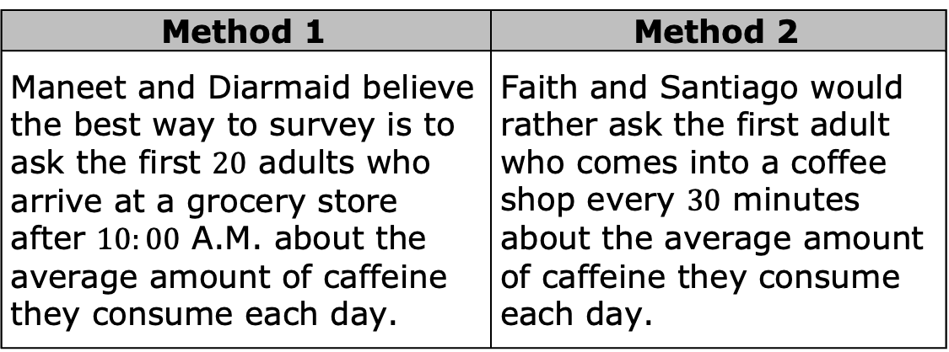
Scenario 2: Maneet, a nutritionist, wants to collect data on how much caffeine the average American drinks per day. She works with three of her colleagues to decide how to survey a sample of the population.
Method 1 | Method 2
Maneet and Diarmaid believe the best way to survey is to ask the first $20$ adults who arrive at a grocery store after $10:00$ A.M. about the average amount of caffeine they consume each day. | Faith and Santiago would rather ask the first adult who comes into a coffee shop every $30$ minutes about the average amount of caffeine they consume each day.
volume 2, pg. 149

Slide 23
What recommendation(s) would you give to this committee about how to select the most representative sample?
volume 2, pg. 149

Slide 24

Exploration
volume 2, pg. 149

Slide 25

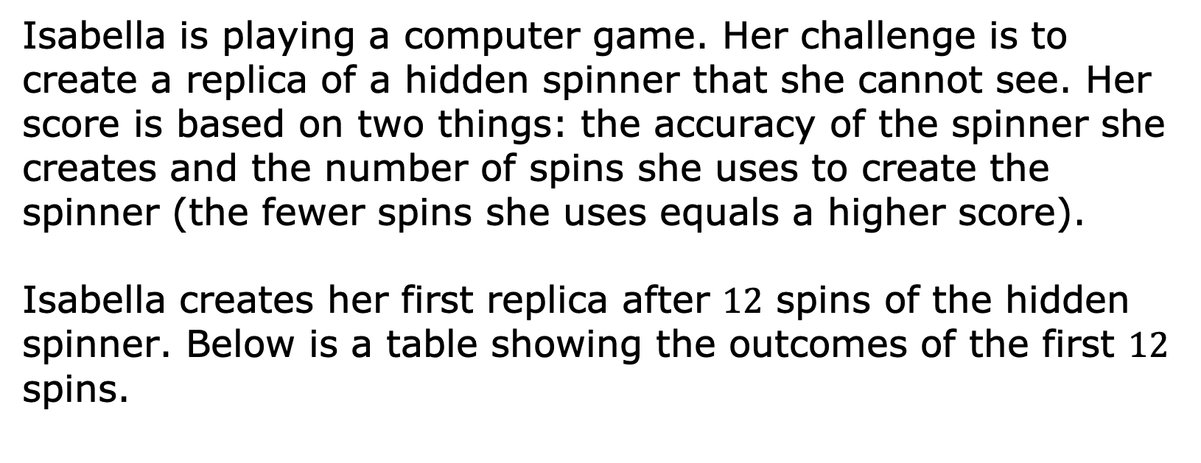
10.8.4 Exploration: Sample Size
Isabella is playing a computer game. Her challenge is to create a replica of a hidden spinner that she cannot see. Her score is based on two things: the accuracy of the spinner she creates and the number of spins she uses to create the spinner (the fewer spins she uses equals a higher score).
Isabella creates her first replica after $12$ spins of the hidden spinner. Below is a table showing the outcomes of the first $12$ spins.
volume 2, pg. 149

Slide 26
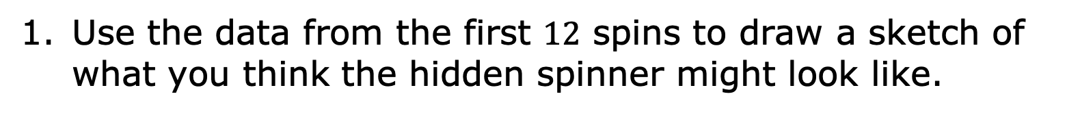
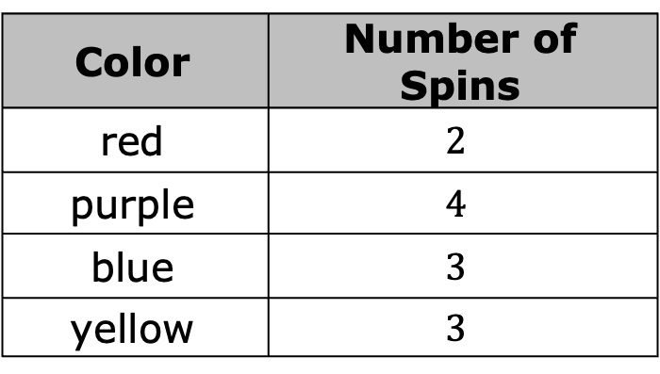
Color | Number of Spins
red | $$2$$
purple | $$4$$
blue | $$3$$
yellow | $$3$$
Use the data from the first $12$ spins to draw a sketch of what you think the hidden spinner might look like.
volume 2, pg. 149

Slide 27
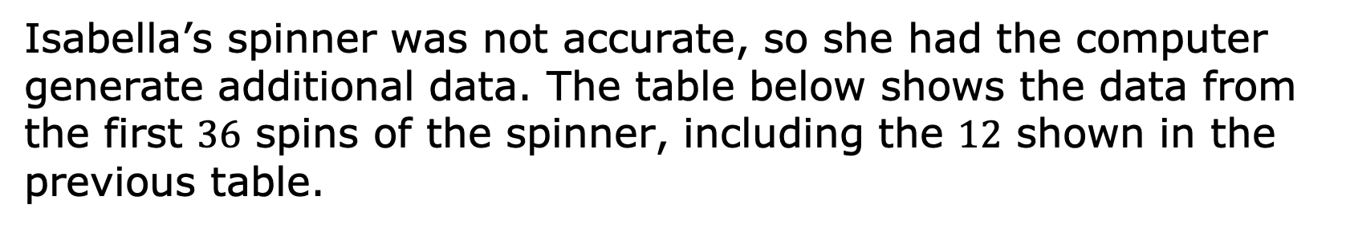
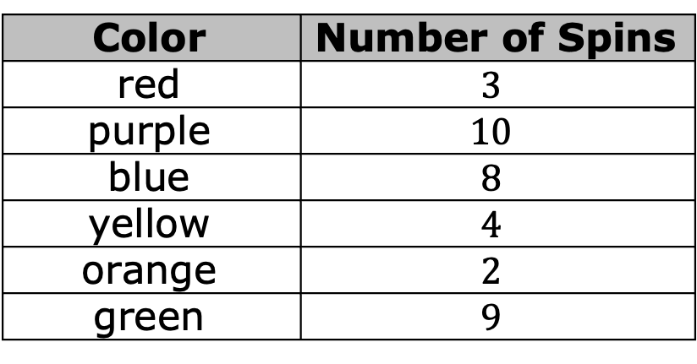
Isabella’s spinner was not accurate, so she had the computer generate additional data. The table below shows the data from the first $36$ spins of the spinner, including the $12$ shown in the previous table.
Color | Number of Spins
red | $$3$$
purple | $$10$$
blue | $$8$$
yellow | $$4$$
orange | $$2$$
green | $$9$$
volume 2, pg. 150

Slide 28
Revise your spinner based on this new data.
Explain which spinner you think is closest to what the hidden spinner looks like.
volume 2, pg. 150

Slide 29
The second spinner Isabella drew was far more accurate than the first. Having additional spins gave a more accurate representation of what the spinner actually looked like. What can this simulation teach us about choosing the size of the sample in a population study?
volume 2, pg. 150

Slide 30

Your Turn
volume 2, pg. 150

Slide 31
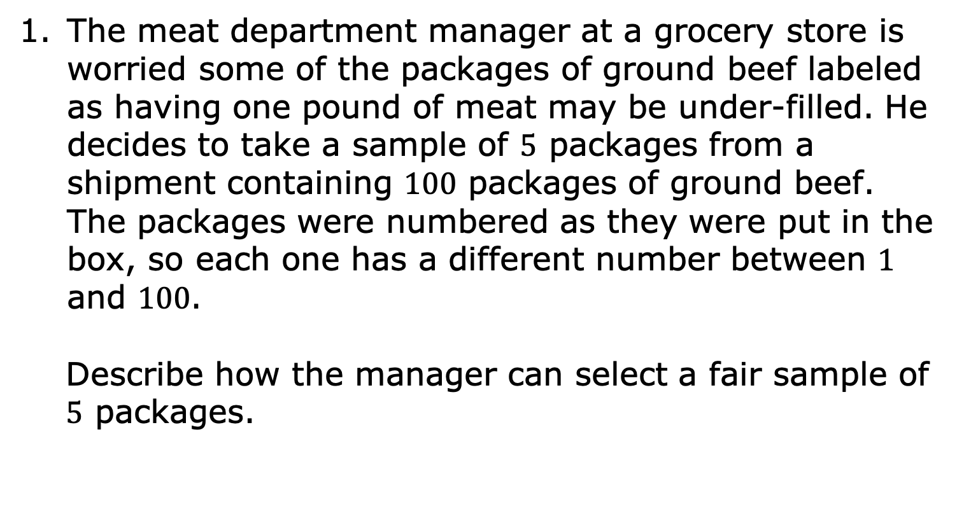
10.8.5 Your Turn!
The meat department manager at a grocery store is worried some of the packages of ground beef labeled as having one pound of meat may be under-filled. He decides to take a sample of $5$ packages from a shipment containing $100$ packages of ground beef. The packages were numbered as they were put in the box, so each one has a different number between $1$ and $100$.
Describe how the manager can select a fair sample of $5$ packages.
volume 2, pg. 150

Slide 32
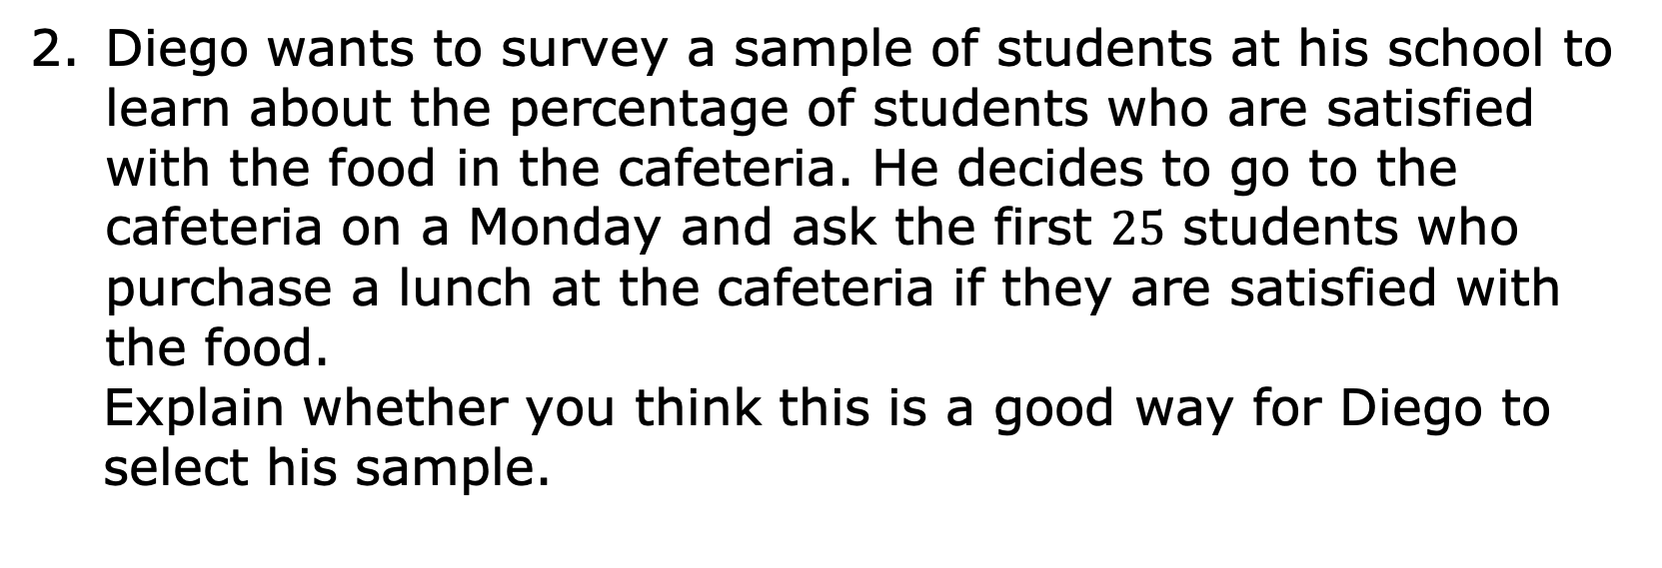
Diego wants to survey a sample of students at his school to learn about the percentage of students who are satisfied with the food in the cafeteria. He decides to go to the cafeteria on a Monday and ask the first $25$ students who purchase a lunch at the cafeteria if they are satisfied with the food.
Explain whether you think this is a good way for Diego to select his sample.
volume 2, pg. 150

Slide 33
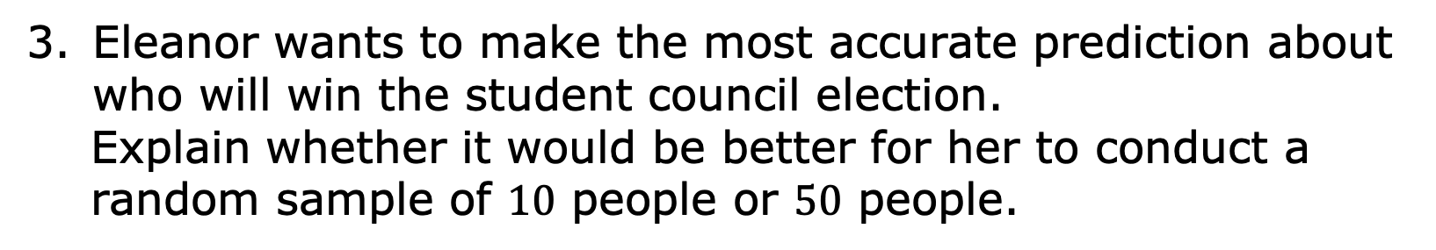
Eleanor wants to make the most accurate prediction about who will win the student council election.
Explain whether it would be better for her to conduct a random sample of $10$ people or $50$ people.
volume 2, pg. 150

Slide 34

Wrap-Up
volume 2, pg. 151

Slide 35
10.8.6 Wrap-Up: Cool Down
Anthony is conducting research to determine how students at his school get to school each day (biking, walking, car, bus, etc.). Because there are many students in his school, he will be conducting a survey of a random sample of students to make predictions about the overall population.
volume 2, pg. 151

Slide 36
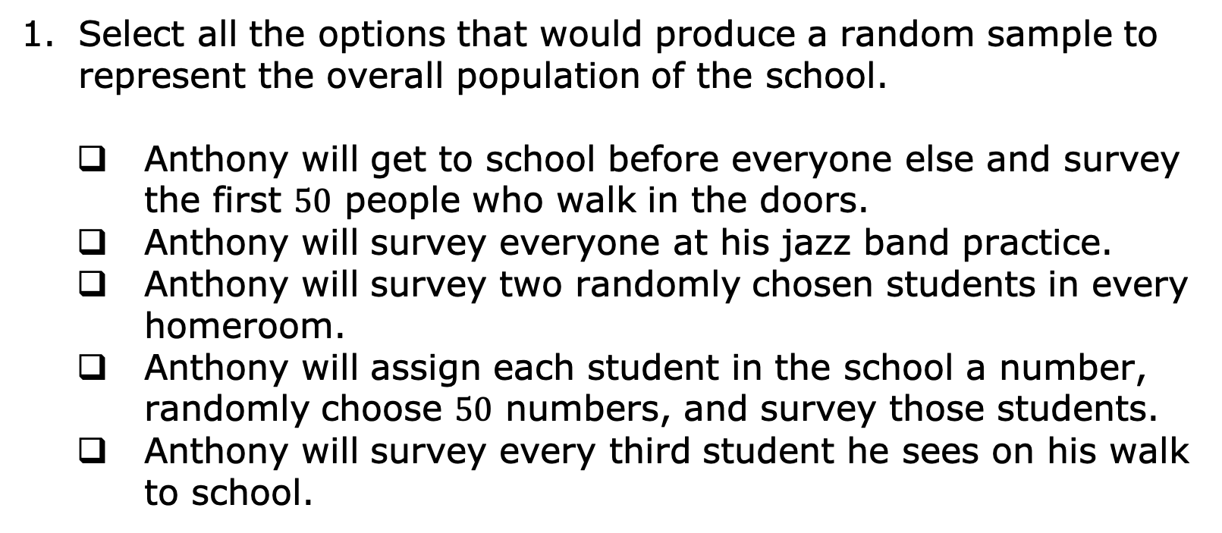
Select all the options that would produce a random sample to represent the overall population of the school.
Anthony will get to school before everyone else and survey the first $50$ people who walk in the doors.
Anthony will survey everyone at his jazz band practice.
Anthony will survey two randomly chosen students in every homeroom.
Anthony will assign each student in the school a number, randomly choose $50$ numbers, and survey those students.
Anthony will survey every third student he sees on his walk to school.
volume 2, pg. 151

